Slide 1


Welcome to English for Programming
Week 4 Class 1
Programmers made by StorySet> <a href="https://storyset.com/web">Illustration by Freepik Storyset</a>

Slide 2

Topics for today
By the end of the class, you will be able to…
share your experiences from the previous Asynchronous Session.
talk about daily activities.
describe places, people, and cultures.
pronounce the sound /s/ in simple present.
identify reading strategies you need to work on.

Slide 3

Tutorial – Review
What did you learn in the asynchronous session?
What did you find interesting?
Are there any questions related to your individual work?
Calendar Flat Illustrations made by Storyset: https://storyset.com/illustration/calendar/rafiki

Slide 4
Part 1: Language Skills

Slide 5

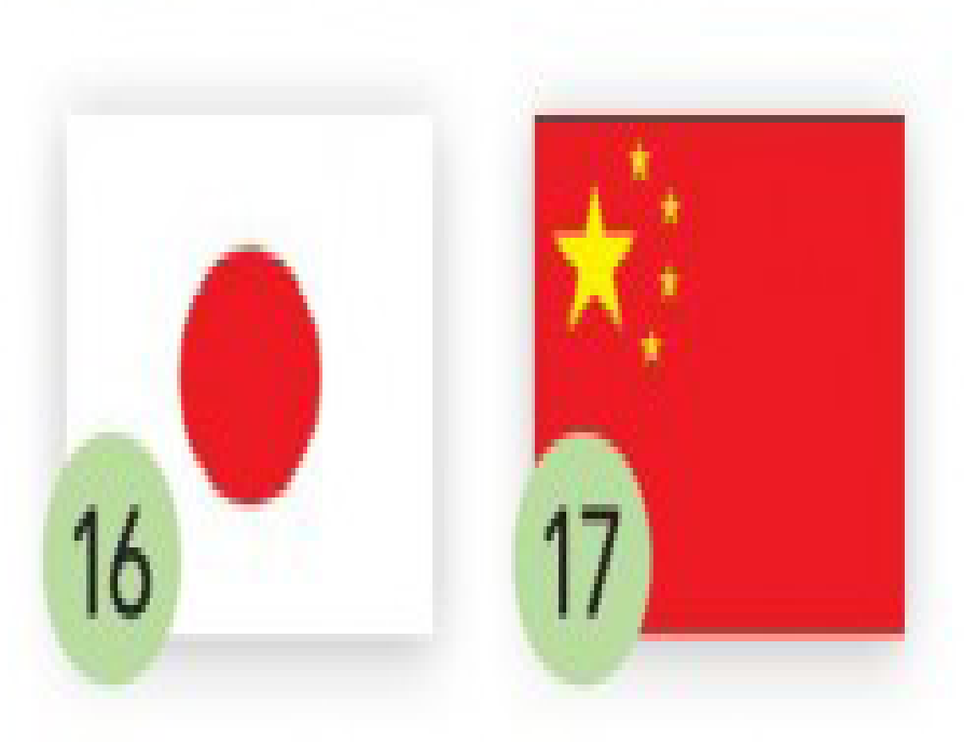



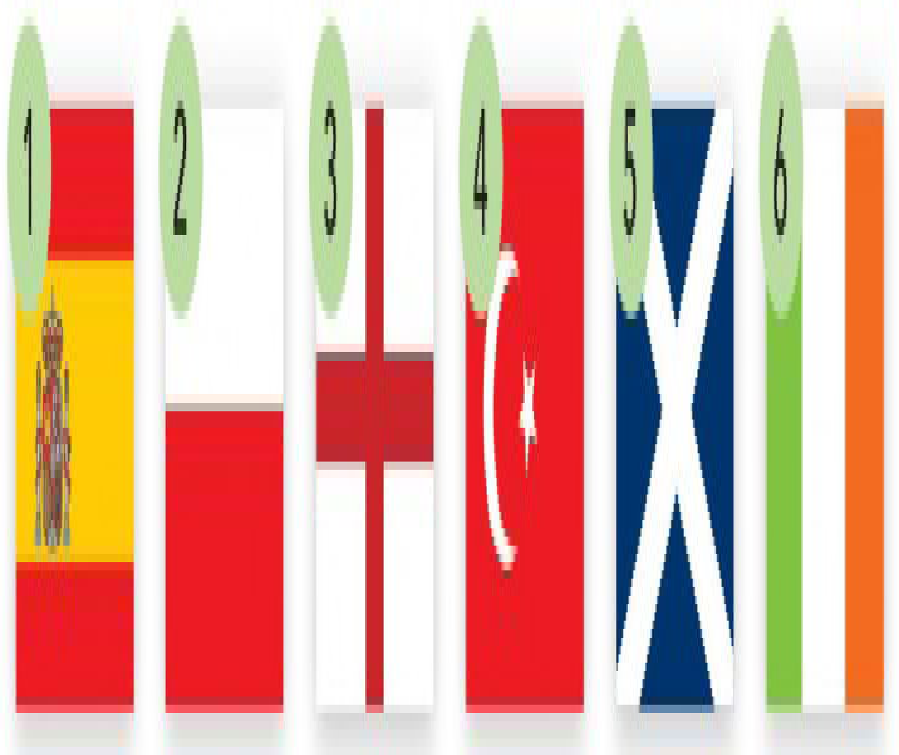
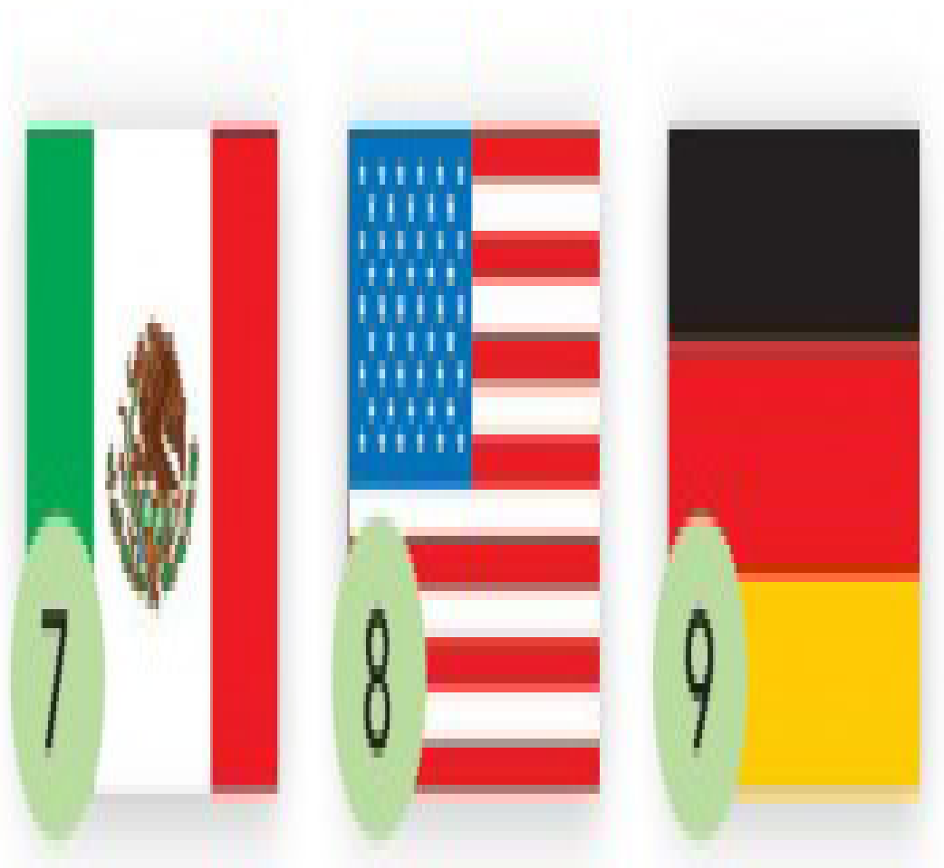

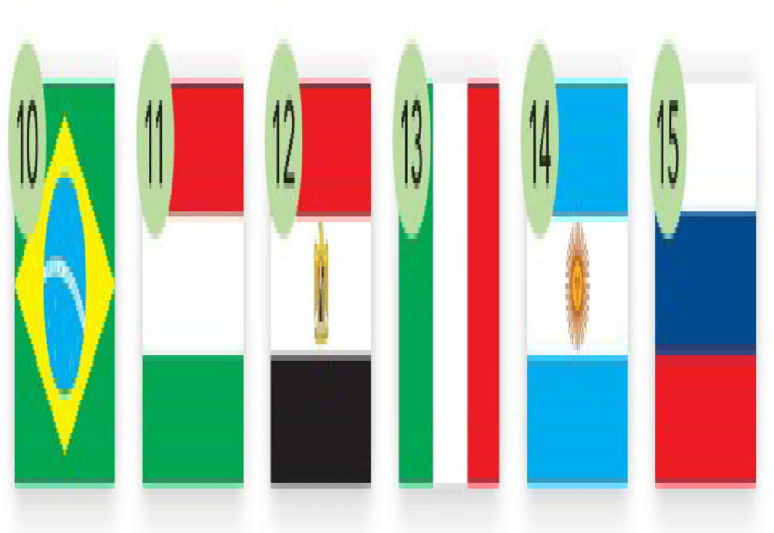
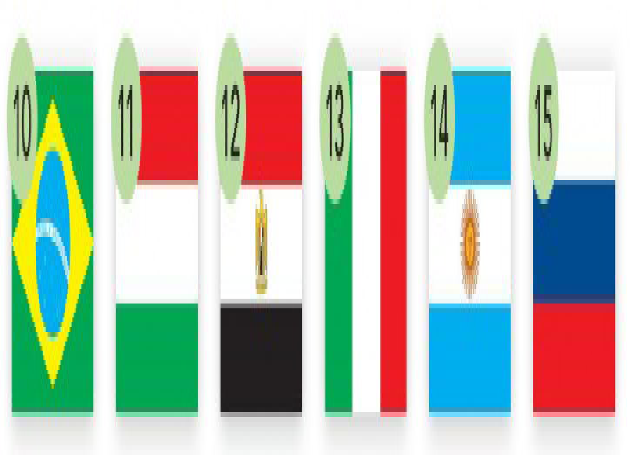
Explore
Can you identify the flags?
Describe the colors and say the country.
Model:
The flag from Japan is white and red.
Notes:
Ss describe/say the colors and which country the flag belong to.
7 MEXICO 17CHINA 10 BRAZIL 16JAPAN 3ENGLAND 1SPAIN 8 USA 9 GERMANY 14 ARGENTINA 13 ITALY

Slide 6

Explore
What do you know about English people?
English people …
eat …
drink ..
play …
watch …
have …
…
…
…
…
England is …
<a href='https://www.freepik.com/vectors/background'>Background vector created by macrovector - www.freepik.com</a>
Notes:
English collage:
They eat fish and chips, drink tea, watch football matches, have a queen, have double decker buses, have rainy weather, play football, have the Big Ben, etc.

Slide 7
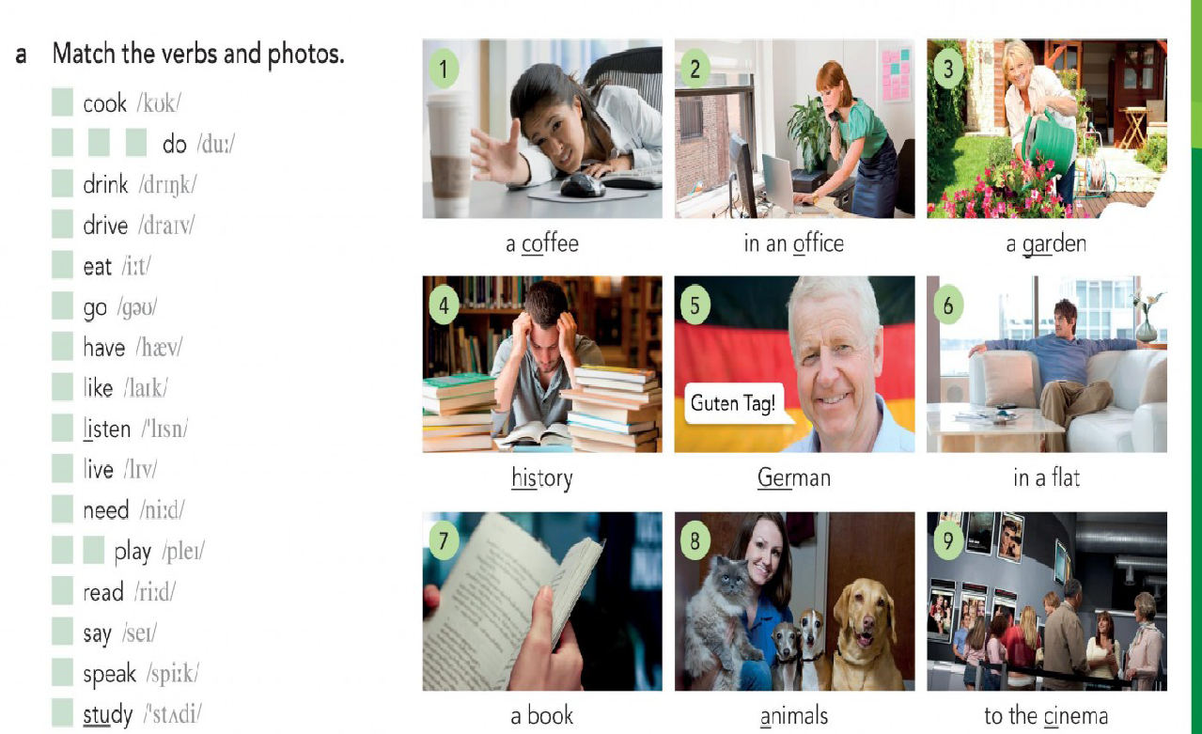

Check
Identify daily activities
Go to your WORKSHEET on page 2 (Verb Phrases).
First, match the verbs or actions with the corresponding photo.
An example has been done for you.
VERB | PICTURE
want | a coffee (1)
Now, listen and check.
Notes:
Tell Ss to go to WORKSHEET PDF _______ VERB PHRASES.
Audio 3.2

Slide 8

Explore
What do people from other countries living in Britain think of that country?
Go to your WORKSHEET page 3.
First, do exercise 4a Reading.
After that, let’s check your answers. Remember to give reasons for them.
Example: Erdal is negative about the UK. He
thinks British people don’t work hard. They
only want to finish work and go home.
Then, do exercise 4b Reading on page 4 of your WORKSHEET.
After that, let’s check your answers. Follow the model: I think number ____ is (read the whole sentence).
Finally, do exercise 4c on page 4.
What are the answers?
Notes:
Answers: _______________________________________________
Teacher classifies the answers: into positive & negative in the following slide.
POSITIVE – CAMILLE / SHUROOQ / MICHELLE
NEGATIVE – ERDAL / KHALAL
POS-NEG – LIAN TANG

Slide 9
Discover
Positive
Negative
The British are friendly.
In the UK women have a lot of freedom.
I like the weather here.
The people are also nice and friendly.
I love British food.
British people don’t work like we do in Turkey.
I don’t like the weather.
I don’t like the food.
I really don’t like fish and chips.
Notes:
POSITIVE – CAMILLE / SHUROOQ / MICHELLE
NEGATIVE – ERDAL / KHALAL
POS-NEG – LIAN TANG
Using some of the opinions from the Reading to elicit the TENSE and the STRUCTURE IN POSITIVE & NEGATIVE.

Slide 10
Language Focus
Present Simple: positive and negative forms
POSITIVE
NEGATIVE
PERSON | TO BE | OTHER VERBS
I | am | play …
you | are | play …
s/he/it | is | plays …
we | are | play …
you | are | play …
they | are | play …
PERSON | TO BE | OTHER VERBS
I | am not | don’t play …
you | are not | don’t play …
s/he/it | is not | doesn’t play …
we | are not | don’t play …
you | are not | don’t play …
they | are not | don’t play …

Slide 11
Language Focus
Uses of Present Simple
To describe the appearance & personality of a person or cultures
To talk or give personal information
To talk about daily activities
The British are friendly.
British people don’t work like we do in Turkey.
The people are also nice and friendly.
Erdal is 39 years old. He is from Turkey.
Khalal is 39 years old. He lives in Newcastle.
Camille is from France. She lives in Liverpool.
Erdal has a café in Cardiff.
He works hard.
Notes:
Using some of the opinions from the Reading, elicit the use of simple present…
Classify the information in:
Describing a person (giving personal information)
to use simple present for personal info: Occupation, nationality, Where live, NAME, Address, Type of housing
Describing a place

Slide 12
Pronunciation
When you talk about SHE/HE/IT in Present Simple, the verb ends in –S, and there are 3 forms to pronounce that final S. The rules are the same as for plural nouns.
/s/
/z/
/iz/
When the final sound is: p, k, t, f (gh, ph)
books
When the final sound is: b, d, g, l, m, n, ng, r, v, a vowel.
keys
When the final sound is: s (c, ss, ch, sh, ge), x, z.
watches
According to the information, how do you pronounce BOOKS, KEYS, and WATCHES?
Now, go to your WORKSHEET page 5 and do exercises 3b.
Do exercise 3c.
Notes:
Exercise 3b – audio 3.6
Exercise 3c – audio 3.7

Slide 13
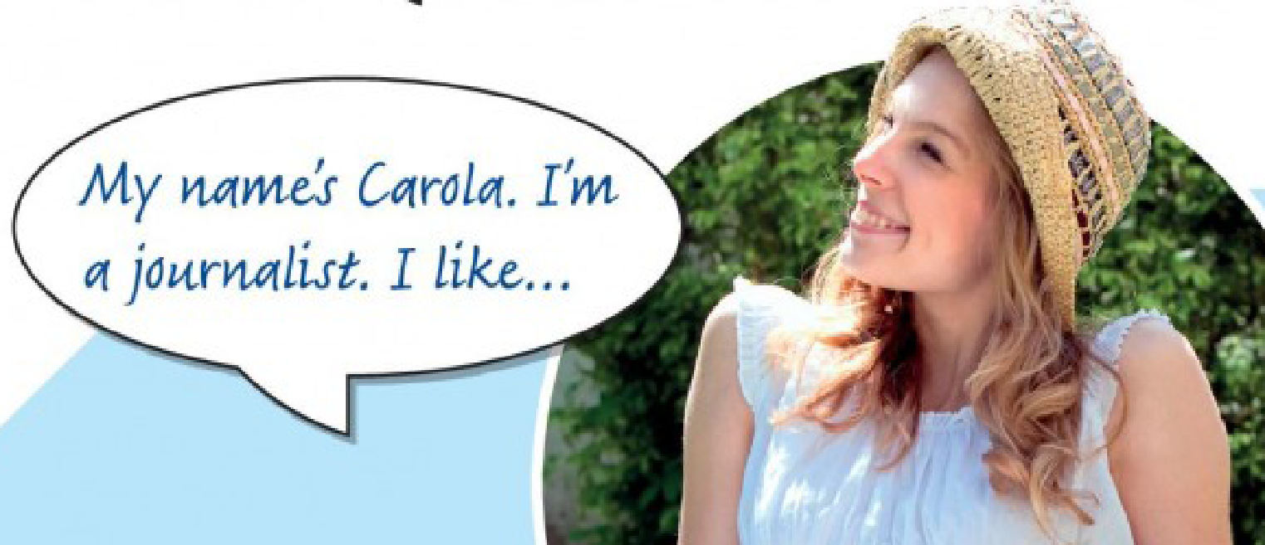
Check
What do British people think of their country?
Go to your WORKSHEET page 6.
Read the text about Carola.
Complete what Carola likes (blank spaces) with the following words:
multiculturalism — gardens — Indian food — pubs
the BBC — the freedom — the language — the weather

Slide 14
Check
Using the information from page 6 of your WORKSHEET. Classify Carola’s information in the 3 categories:
To describe the appearance & personality of a person or cultures
To talk or give personal information
To talk about daily activities
People from all over the world live in the UK, and they live together happily. Usually.
I speak English.
When the sun’s out, I sit in the garden.
Notes:
Ss complete the three charts using the information about Carola.
Column 1
Column 2
Column 3

Slide 15

Practice
Go to your WORKSHEET page 6. In pairs or groups do the following activities:
Do exercise d Practice.
Then, do exercise e Practice.

Slide 16

Practice
Go to your WORKSHEET page 7. In pairs or groups do the following activities:
Do exercise 5a More Practice.
Then, do exercise 5b More Practice.

Slide 17
Part 2: Reading

Slide 18
Reading Practice
Go to your WORKSHEET page 8 to review the reading strategies:
Parts of Speech
Cognates
Word Families
Scanning
Meaning from Context
Notes:
Teacher open the Student Worksheet and work with the students.

Slide 19


Autonomous Asynchronous work
MasterTech Platform: My Learning Menu 4.1
1 Appetizer (optional)
Whole Main Course (Important)
1 Dessert(optional)
Bring your questions next class!
Homework Semi Flat Illustrations
made by StorySet <a href="https://storyset.com/education">Illustration by Freepik Storyset</a>

Slide 20

See you in our next class when you will learn:
Review the content from your asynchronous session
Talk about jobs and problems at work
Create a survey using Present Simple Tense
Review reading strategies: skimming, scanning and vocabulary skills
Online made by StorySEt> <a href="https://storyset.com/online">Illustration by Freepik Storyset</a>

Slide 21

Thank you!

